Slide 1
Porter Simulation Tool
Vitaliy Kondratiev
Nathan Johrendt
Mark Gammie
Tyler Lyn

Slide 2
The Stakeholders
Hamilton Health Sciences
Corey Stark (CSS - Sodexo Systems and PerformanceManager)
Kym Kempf (Business and ProgramManager - Corporate Services)
David DiSimoni (SiteManager - Customer Support Services)
Anita Lamond (Director - Corporate Services)
Steve Metham (Manager - Quality)
Mohammad Majedi (Quality Specialist)
Talha Hussain (Quality Specialist)

Slide 3
The Problem
Porters are key piece of the overall patient experience
HHS are experiencing inefficiencies in their porter services
Porters should be able to achieve greater efficiency
Minimization of client wait times
Reduce total time wasted in operations
There is a need for empirical evidence to support/disprove new ideas or initiatives

Slide 4
The Scope
Up to 7 day simulation
Concentrate on porter wait times
Exclusive use of real world statistical data
Mimicking of the dispatching system

Slide 5
The Requirements
Easy to operate
Quick to execute
Provide relevant results data

Slide 6
Design Overview
Extremely streamlined work flow
Basic Interface Settings → Input of Data Files → Statistical Graphs

Slide 7
Demo I

Slide 8
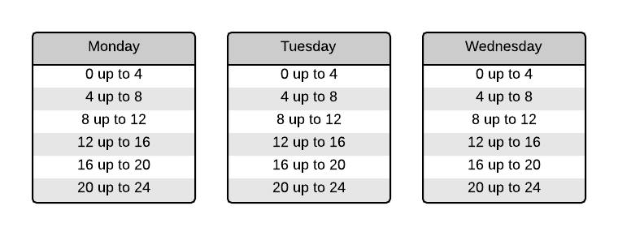
The Simulation Data Sampling
Start day: Monday
Duration: Three days

Slide 9
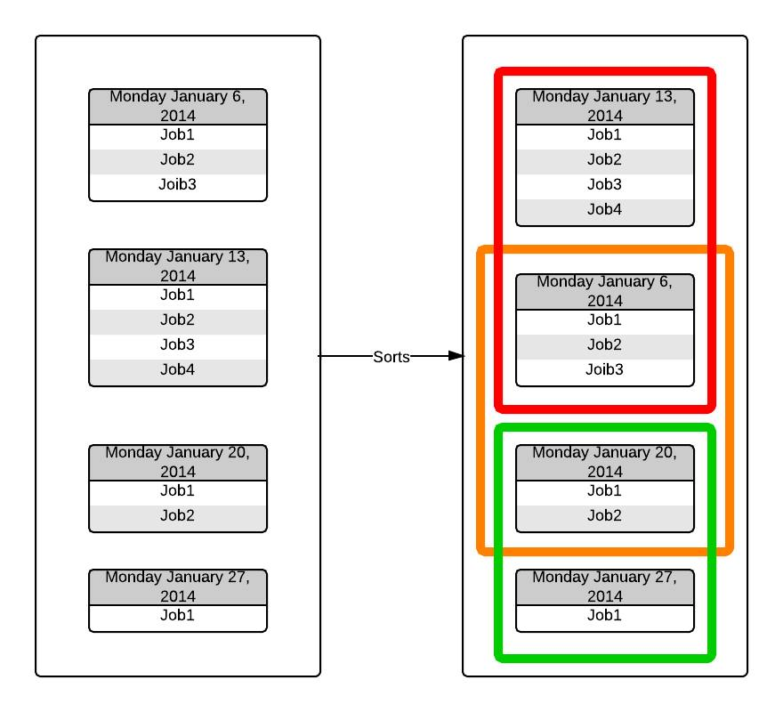
The Simulation Data Sampling

Slide 10
Demo II

Slide 11
The Dispatcher Design
Based off the requirement documentation provided by HHS
Algorithm that organizes pending jobs assigning each a Dispatch Value (DV)
Job with the highest Dispatch Value in the queue will be assigned to the next available porter
Dispatcher will increase the job priority of each job in its queue over a configurable amount of time
Dispatch Value = Job Priority * Appointment Factor

Slide 12
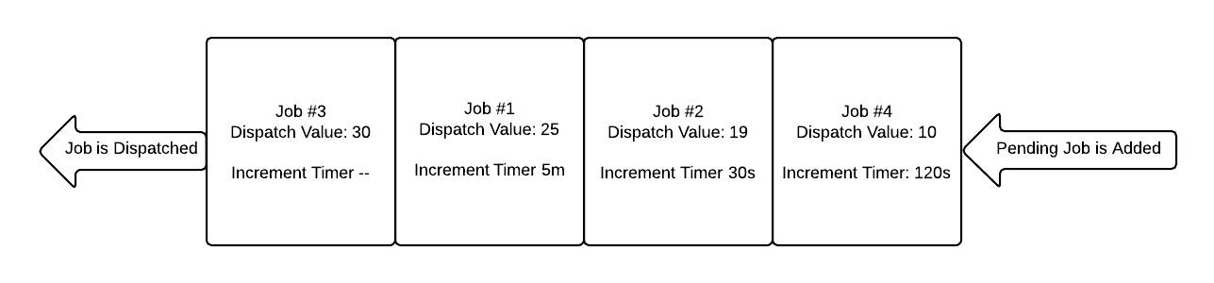
The Dispatcher Design

Slide 13
Demo III

Slide 14
Future
Convert the software to a web application allowing more access to more users outside Juravinski
Allow for more portable output not anchored down by the excel application
Graphical Interface for Schedule Creation
Flexibility to be implemented to other health institutions and their data sets

Slide 15
Thank You

